Slide 1

VEHICLE DETECTION AND SPEED ESTIMATION
MINI PROJECT
Guided by : Prof. Vrishali Chakkarwar
Notes:
Good morning everyone. My name is Shrutika Gedam. Our project name is vehicle detection and speed estimation.

Slide 2
TEAM MEMBERS
TEJASHRI SHENDE
SHUBHAM NAGULWAR
ANJALI JADHAV
SHRUTIKA GEDAM
BE19F05F058
BE19F05F036
BE19F05F021
BE19F05F016
COMPUTER SCIENCE AND ENGINEERING
CLASS : THIRD YEAR
Notes:
my team members are Tejashri Shende, Anjali Jadhav and Shubham Nagulwar.

Slide 3
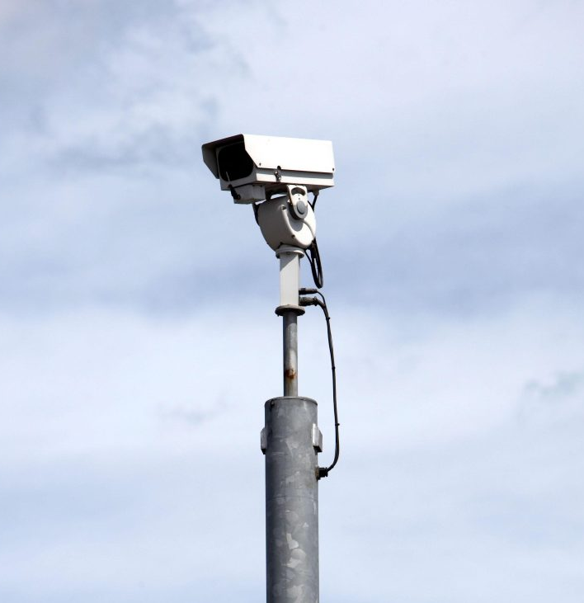
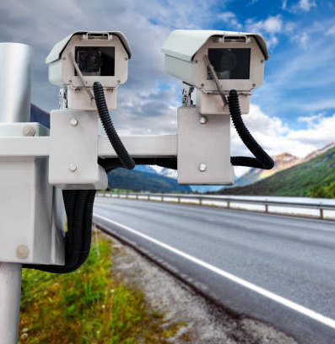
AIM
This project will focus on making a speed camera without sensors and only with Image processing of videos.
Notes:
The aim is of our project is to make a system by which we can detect the vehicle and simultaneously record the speed of the vehicles without using a sensor based technology.

Slide 4
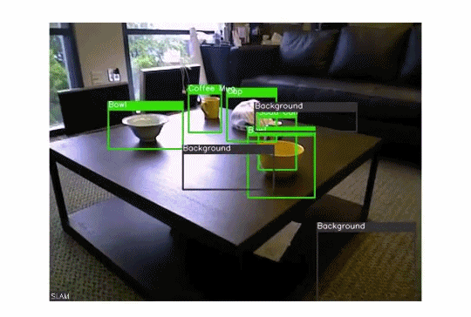
Introduction
Vehicle detection is one of the widely used features by companies and organizations these days. This technology uses computer vision to detect different types of vehicles in a video or real-time via a camera. It finds its applications in traffic control, car tracking, creating parking sensors and many more.
Notes:
Hello mam I’m Shubham let me introduce you to the project
In this project, we have build a car tracking system in python for pre-recorded videos.
Object detection is a fascinating field in computer vision. It goes to a whole new level when we’re dealing with video data. The complexity rises up a notch, but so do the rewards!
We can perform super useful high-value tasks such as surveillance, traffic management, fighting crime, etc. using object detection algorithms.
There are a number of sub-tasks we can perform in object detection, such as counting the number of objects, finding the relative size of the objects, or finding the relative distance between the objects. All these sub-tasks are important as they contribute to solving some of the toughest real-world problems.

Slide 5



Software Used
Python IDE (Pycharm and VS Code)
OpenCV
Numpy
Notes:
(DO NOT READ JUST EXTRA INFORMATION)
OpenCV makes use of Numpy. All the OpenCV array structures are converted to and from Numpy arrays.
OpenCV-Python : This repository contains just the main modules of the OpenCV library.
opencv-contrib-python : The opencv-contrib-python repository contains both the main modules along with the contrib modules

Slide 6
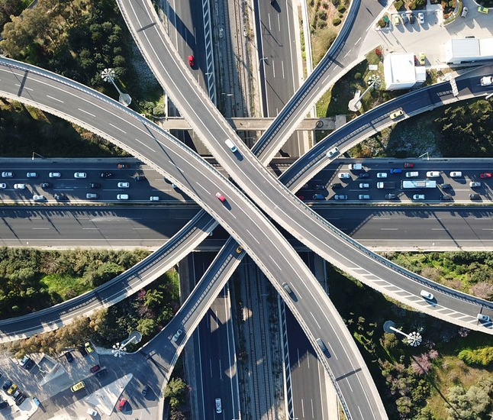
FEATURES
Detecting the vehicle
Predicting the speed of vehicle
Give unique id to the vehicle
Capture image of vehicle
Count total number of vehicles
Save data in the file
Notes:
Read the slide

Slide 7
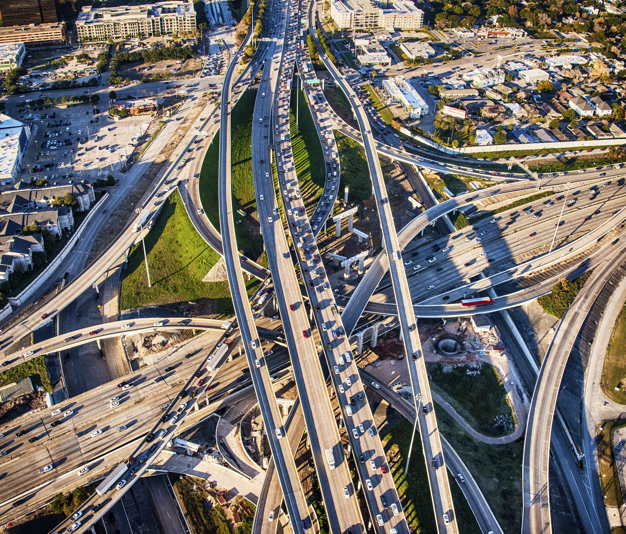
USE/NEED
To detect the speed of the moving vehicles
To limit the speed of the vehicles
Provides appropriate information about traffic flow
Vehicle crash occurrences
Traffic peak times in roadways
Notes:
Mam the need of this project is one of the most important factor why we chose this project. In the recent years we can see there is a vast increase in the number of vehicles all around the globe. Along with the increase in number of vehicles increases the number of accidents. Therefore, it is important to limit the speed of the vehicles at certain zones or areas. Radar speed measurement tools are commonly used for this purpose which can be inaccurate in certain cases such as in sensing smaller vehicles with weaker echoes. The Indian traffic police uses the radar measurement system on a wide scale ,I am not saying that this technology is bad or something but this is outdated and even costly ,by using vehicle detection we can not only just detect the speed of the vehicle but also we can do a lot more of things like counting the number of objects, finding the relative size of the objects, or finding the relative distance between the objects .Also it is difficult for these tools to detect vehicles changing in speeds too often or fast. Therefore, there is a need for a better technique to detect the speed of the moving vehicles. Than using expensive sensors such as radars, the vehicles video streaming could be used for this purpose. The video stream of the moving vehicle is given as an input, then it is passed through the filter for detecting its speed.

Slide 8
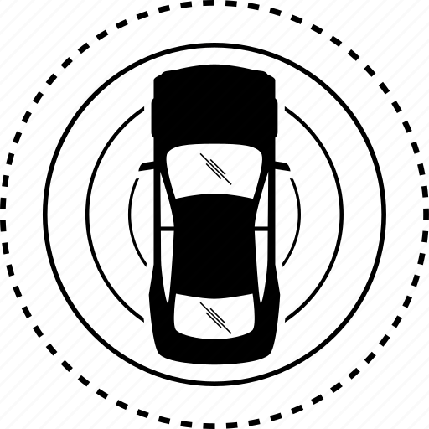
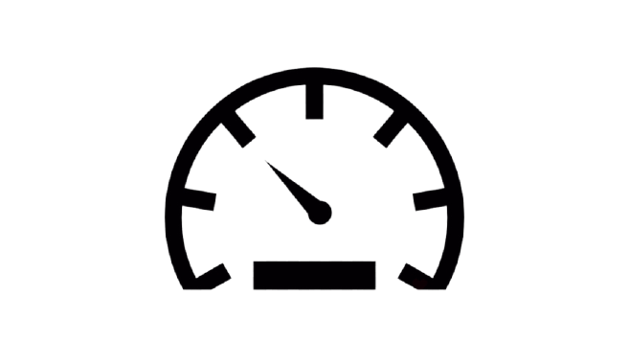

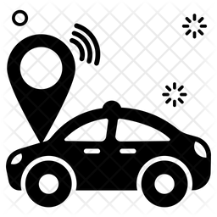
Four Main Parts of the Project
TRACKER
SAVE
DATA
3
VEHICLE DETECTION
SPEED
ESTIMATION
2
1
Notes:
Mam our project is divided into 4 main parts that is & at last saving the data

Slide 9
PROJECT MODEL
TRACKER
SPEED ESTIMATION
DETECTION
SAVE DATA
Input Vedio
Object tracking
Start Timer and Save in Array
Crop Image based on contour detection
Image Subtraction
Find center of Bounding Box
Stop Timer and Save in Array
Save Vehicle Image in File
Masking and Erosion
Display ID Bounding Box
Calculate Speed and Save in Array
Save ID and Speed in Text File
Contour Detection
Display Speed Bounding Box
Add summary in the end of text file
Draw Bounding box
Notes:
Mam our project is divided into 4 main parts that is & at last saving the data

Slide 10
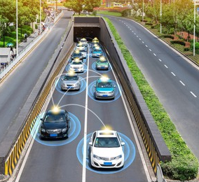
VEHICLE DETECTION

Slide 11
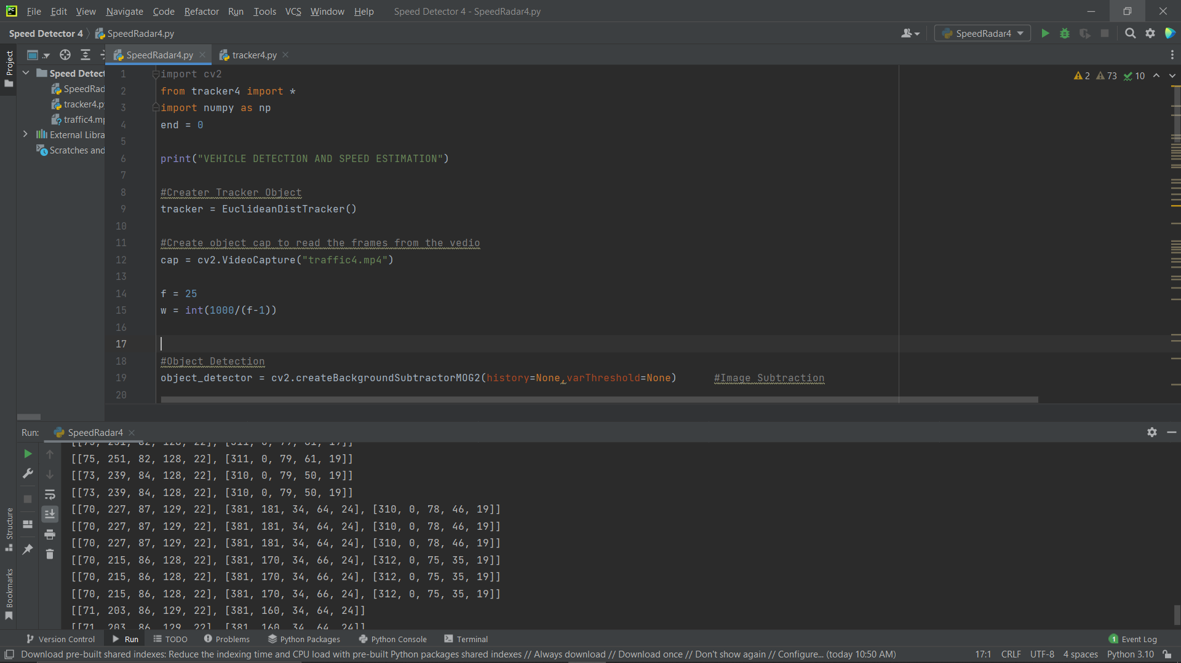
Import OpenCV, NumPy python models, and tracker file.
Create Tracker Object.
Read video frames
Notes:
Here we are importing OpenCV and NumPy libraries to start our project.
We also import tracker4 file.
Then we create object named tracker of the class EuclideanDistTracker().
This is the tracker that takes all the bounding boxes of the object and store it into one array. Which is further used in tracking the object and associate speed with respective object.

Slide 12
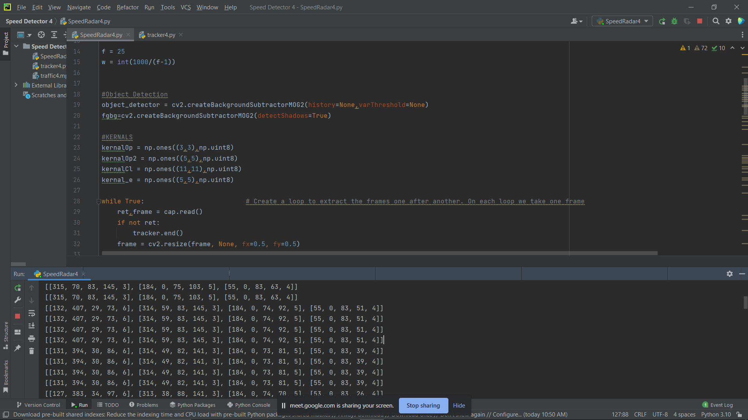
Object detection by background subtraction.
Declare kernal
Notes:
This is where the detection begins
We have to create an object detector to extract moving object from the static background, that is we have applied background subtraction on the video frames.
In morphological operations we use kernal as structuring element to adjust the pixels. Therefore according to the requirement for our project we have declared different sizes of kernel.
In mask operations the value of each pixel of an image is recalculated based on a given mask matrix, this is known as the kernel.

Slide 13
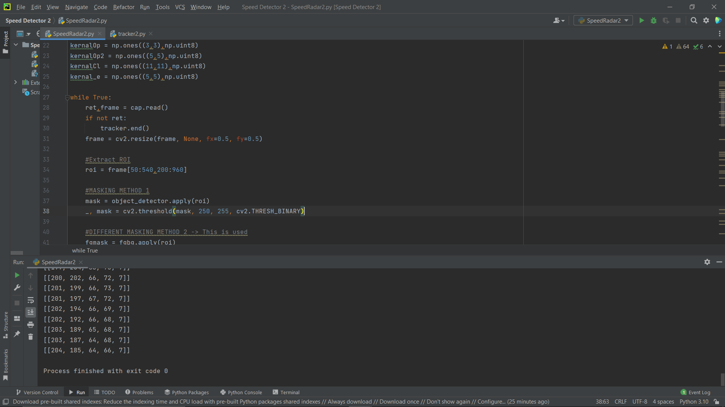
Read video
Resize frame (if needed)
Region Of Interest (ROI)
Notes:
As we know that the video is collection of images so we read the video, by creating a while loop to extract the frames one after another. On each loop we take one frame to process. For reading the video we will be using function cap.read().
According to our requirement we are changing the size of the frame. Image resizing refers to the scaling of images. It helps in reducing the number of pixels from an image.
ROI is the area within the frame where we want to search for the object. We focus on this region for accurate detection. Resizing the frame of ROI according to our need and convinence.

Slide 14
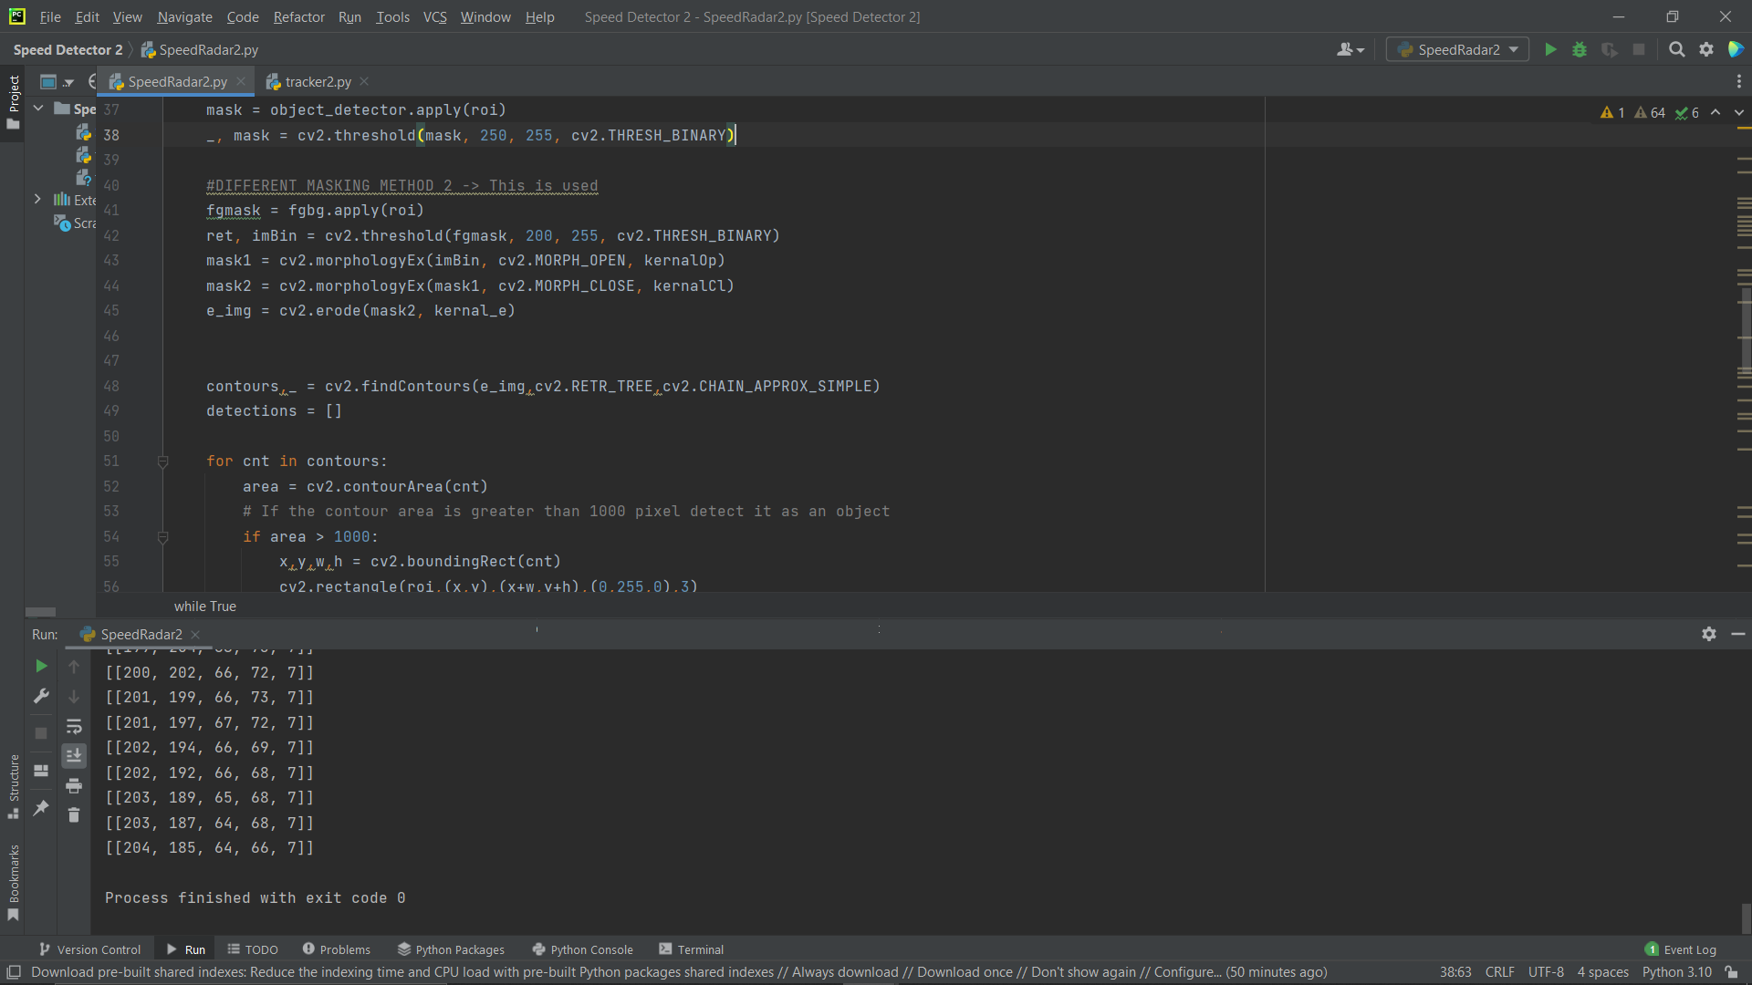
Masking
Erosion
Contours
Notes:
Masking is a technique used to highlight a specific object from the image. In this technique, we set certain pixels of an image to some null value such as 0 (black color) so only that portion of our image is highlighted where the pixel value is not 0.
. Morphological image processing basically deals with modifying geometric structures in the image. Erosion is morphological image processing operations which basically strips out the outermost layer of pixels in a structure. It computes a local minimum over the area of given kernel.
Contour are defined as the line joining all the points along the boundary of an image that are having the same intensity which helps in shape analysis, finding the size of the object of interest, and object detection. findContour() function helps in extracting the contours from the image and save the co-ordinates of the detected object in the form of array.

Slide 15
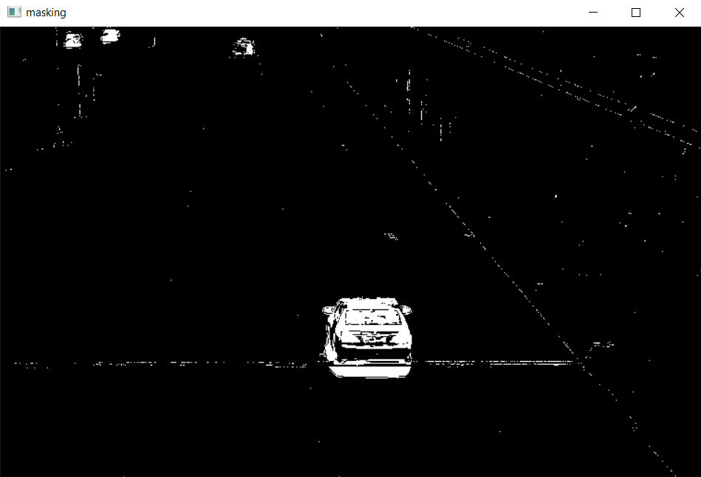
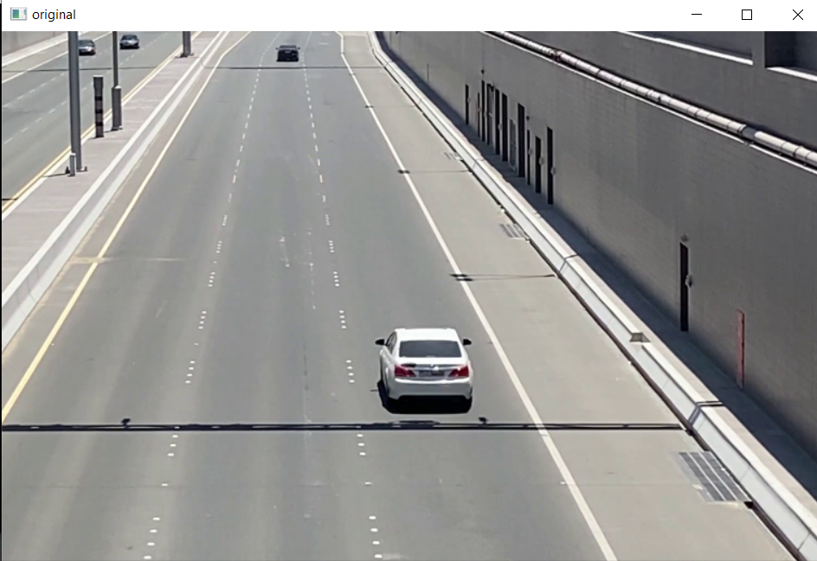
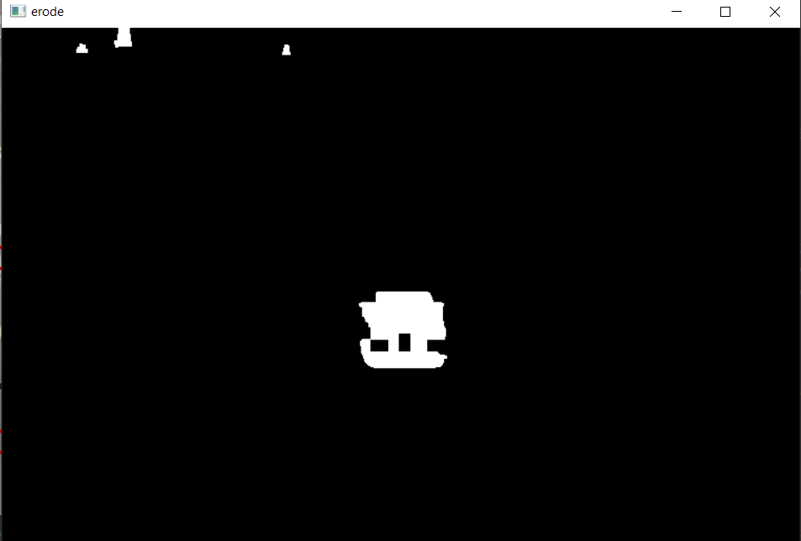

Slide 16
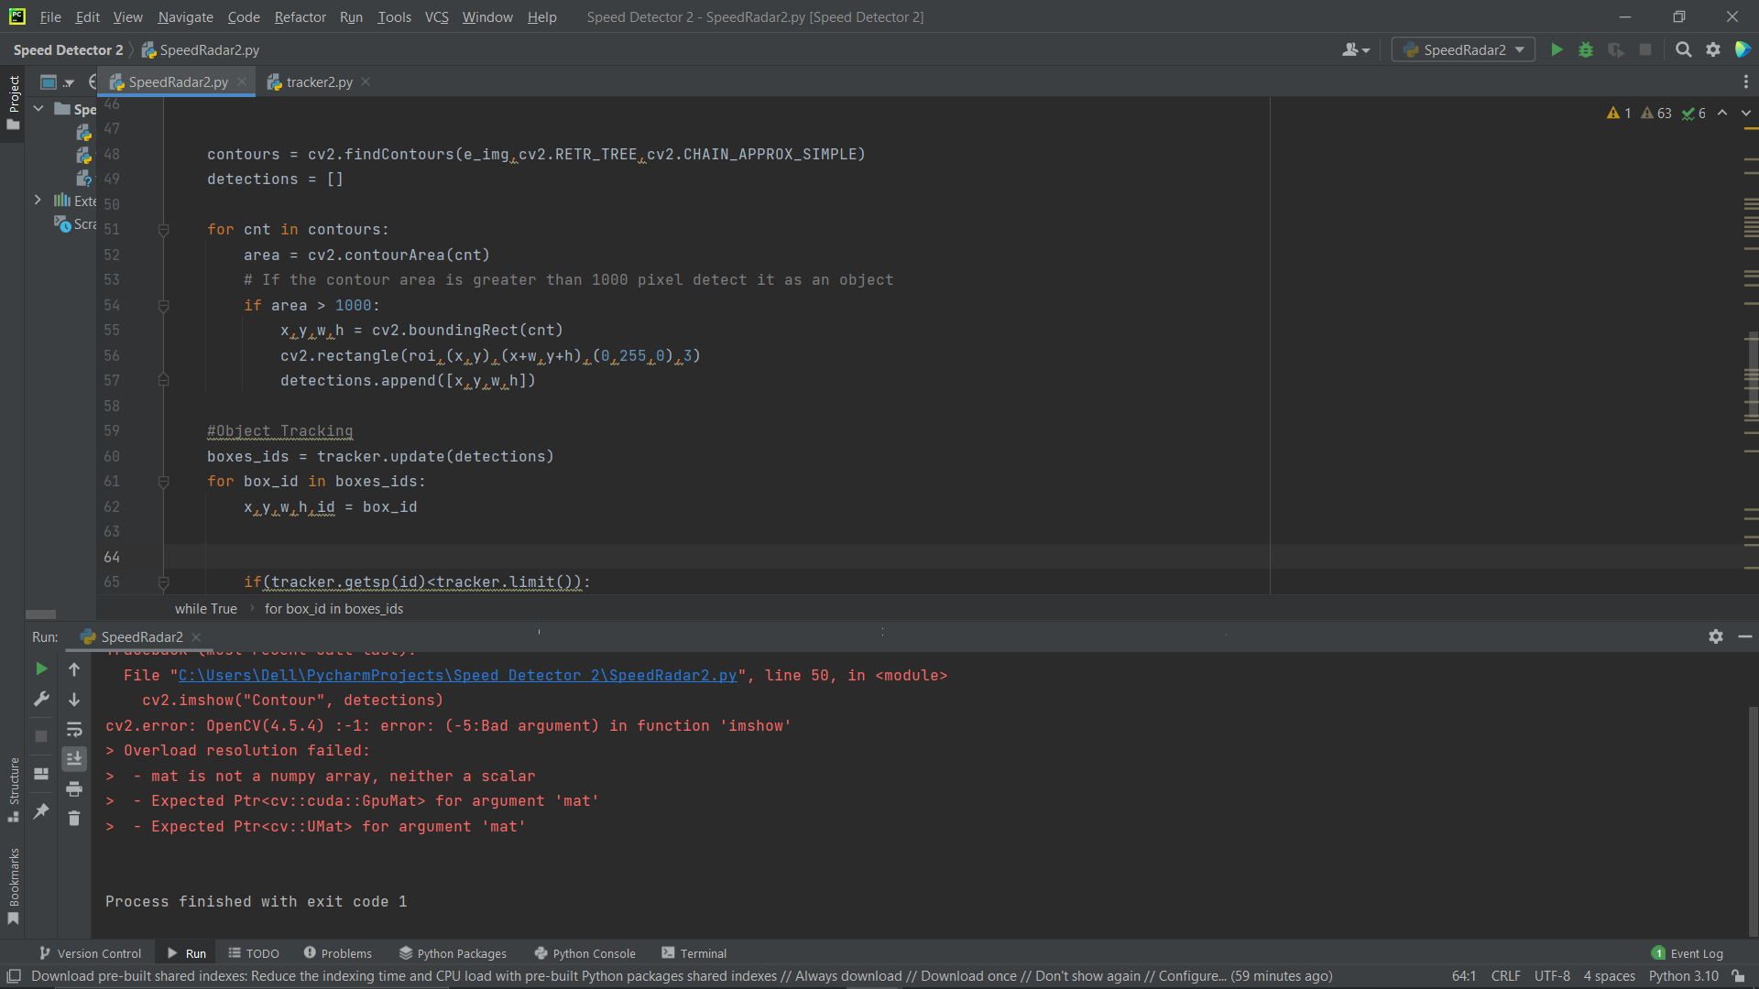
Contour Area
Create Bounding Box
Notes:
Contour area refers to the area enclosed by all pixels in each contour. Here if the contour area is greater than 1000 pixel, then it is detected as an object.
Now we create a rectangular bounding box around the detected object. Each bounding box has x an y co-ordinates, width and height, and we store this data in list for further use.

Slide 17
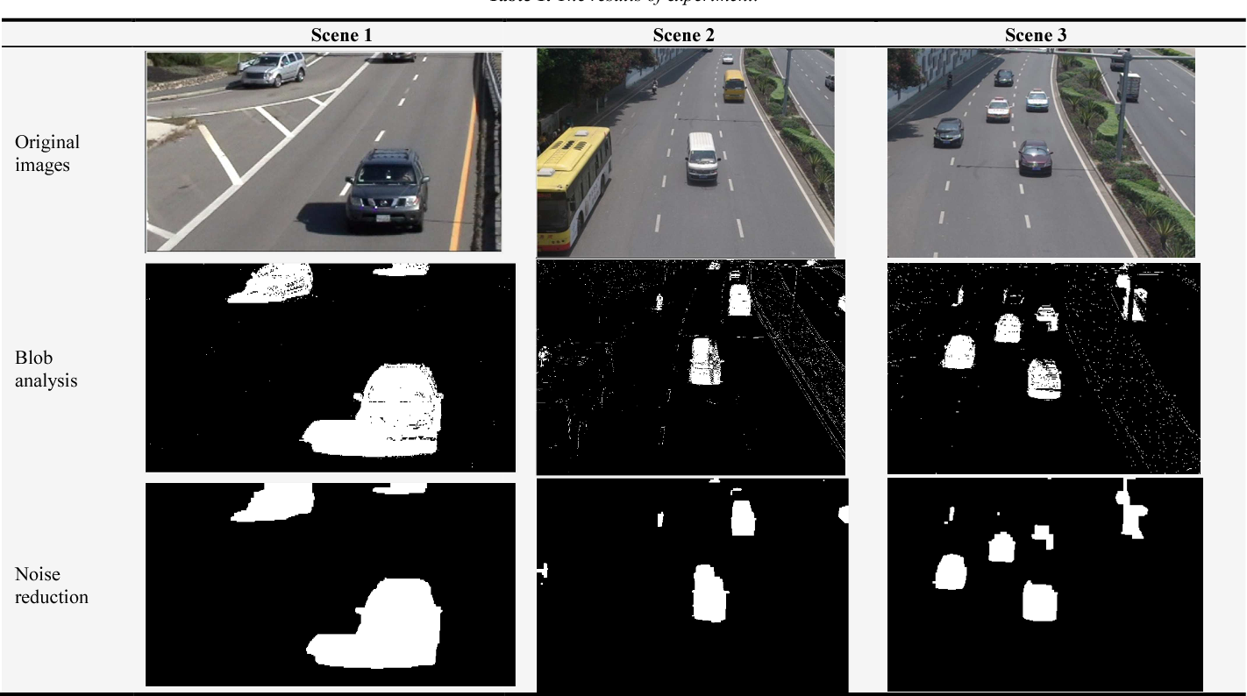
TRACKER
Notes:
Now let’s see how the tracker works.

Slide 18
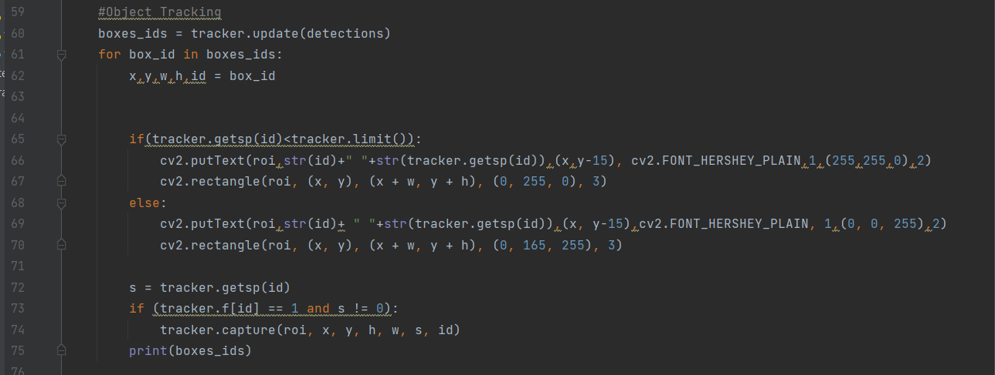
Give ID
Display ID on bounding box
Notes:
We pass the list named detection in tracker.update(), which gives us ID with the co-ordinates of bounding box. If the speed of object is within the defined speed limit then the bounding box will be green else it will be red. With the help of cv2.putText() we have displayed ID and speed on the bounding box.

Slide 19
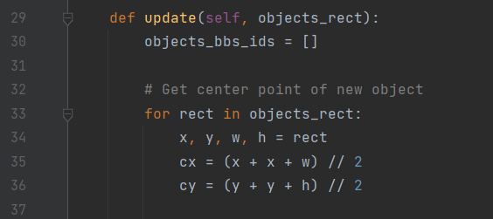
Update ID in array
Calculate centre point of object
Notes:
Update the ID given to each bounding box in the array along with the other parameters of bounding box.
To calculate the co-ordinates of center of bounding box of vehicle we will need the parameters that is the x and y co-ordinates, width and height of the bounding box. Applying center point formula we find the x and y co-ordinates of center point.

Slide 20
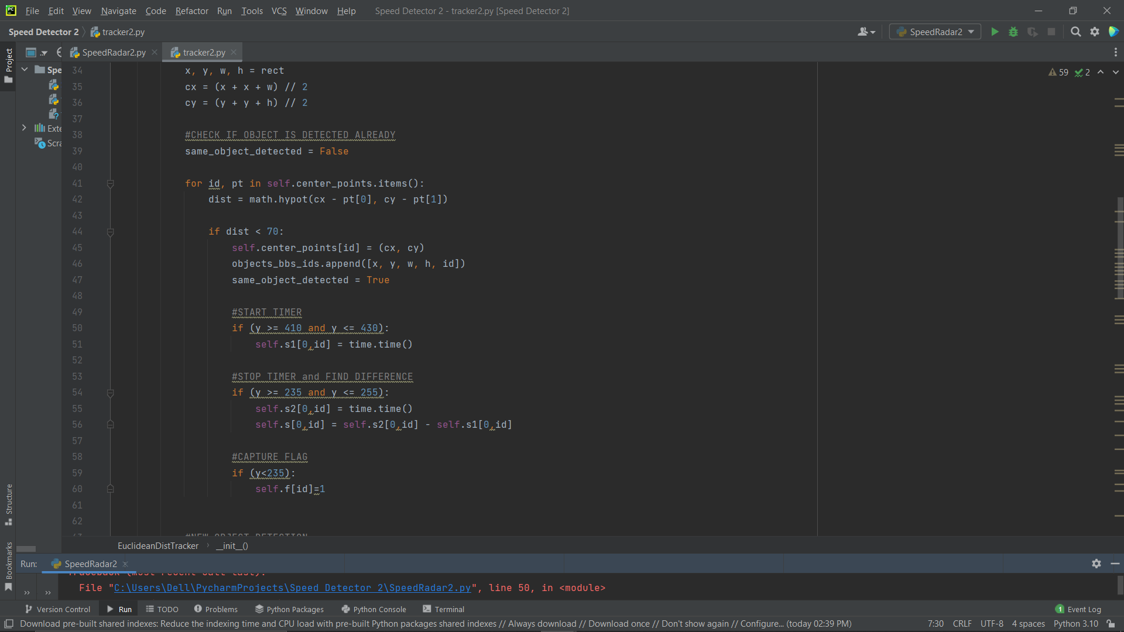
Check if object is already detected.
Notes:
To check if the object detected in two consecutive frames is same or not we have applied for loop. If the distance between the center points in a bounding box in two consecutive frames is less than 70 pixel than both bounding box are same. This makes the condition true and we proceed to speed calculation.

Slide 21
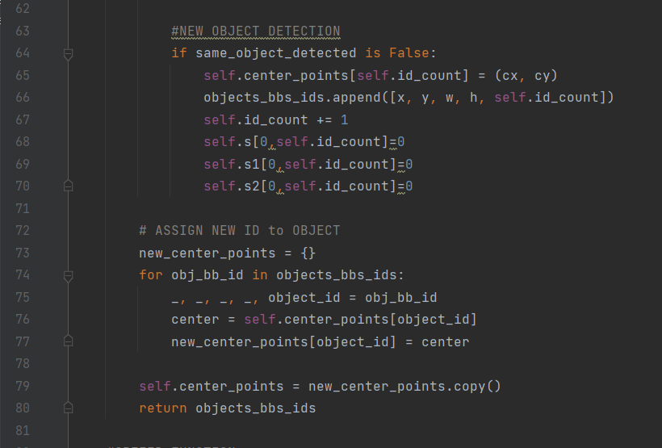
New object Detection
Assign new ID
Notes:
If the distance between the center points in a bounding box in two consecutive frames is greater than 70 pixel than both bounding box are different. This means new object has been detected, for which we calculate a new center point co-ordinates and assign new ID to it.

Slide 22
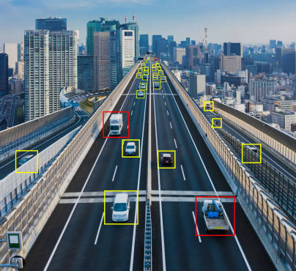
SPEED ESTIMATION

Slide 23
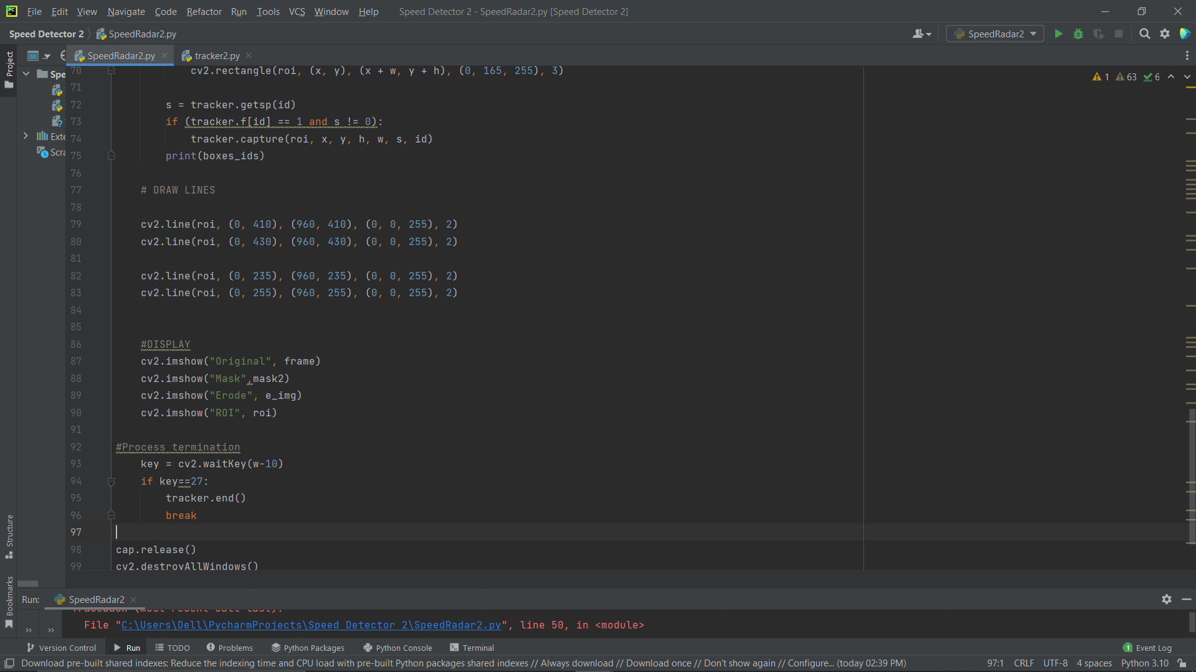
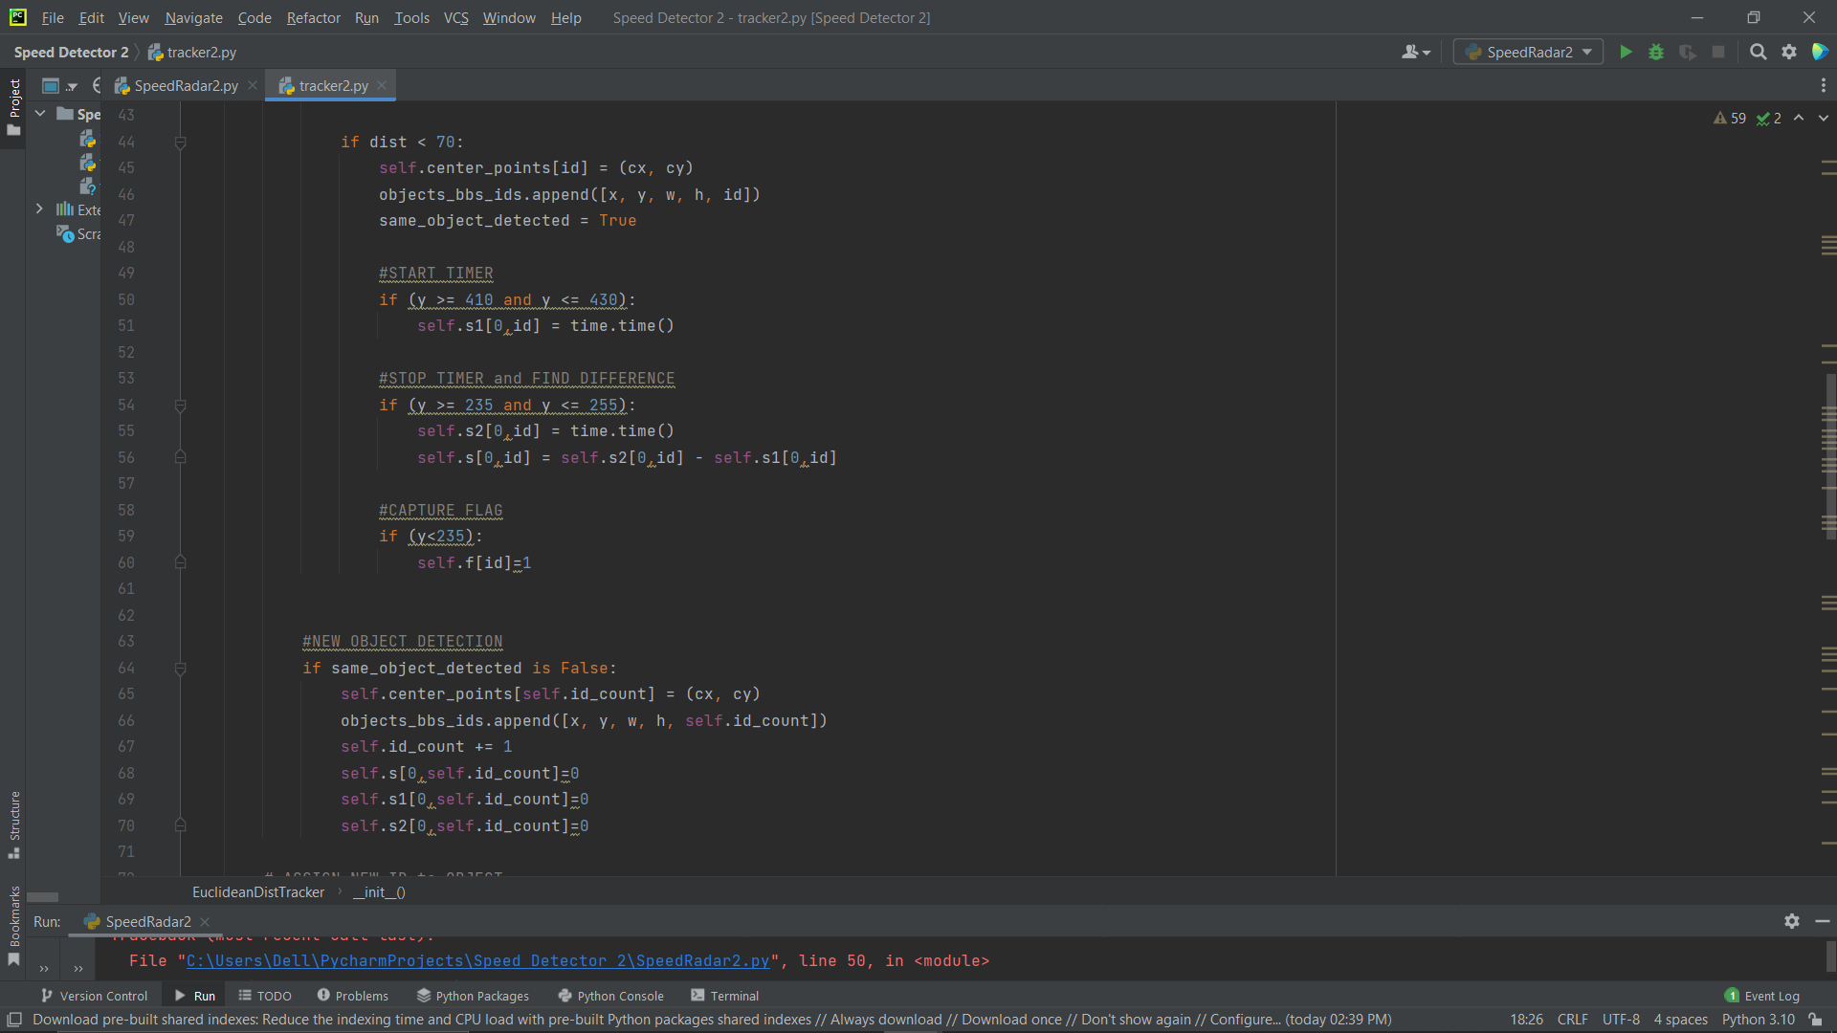
Draw timer lines
Record and store time in array
Notes:
We have drawn four lines on the frame, these are timer lines.
When the object is between lines with co-ordinates 410 and 430 the timer is started, which is further stored in array s1 with the ID of the object.
Similarly, When the object is between lines with co-ordinates 235 and 255 the timer stops, and is stored in array s2 with the ID of the object.
Next we calculate the time required to travel between the two set of lines by subtracting the recorded time given to the same ID and store the result in array s with ID.
The reason why there are four lines is to estimate speed accurately when vehicles come simultaneously.

Slide 24
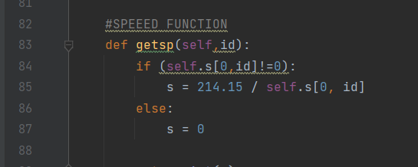
Calculate speed
Notes:
To calculate the speed, first we get the time and ID of object. Then, if the time element in array ‘s’ is not zer0 we divide distance between the lines by the time stored in array s and calculate speed. If the time element in array s is zer0 we print speed zero. The distance between the lines is measured from the video. It varies for different video.

Slide 25
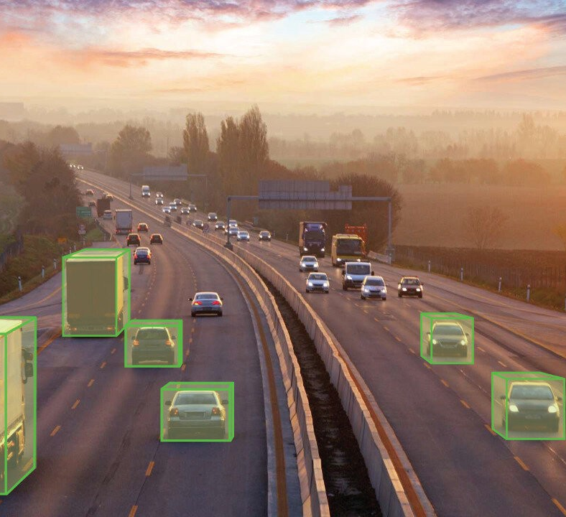
SAVE DATA

Slide 26
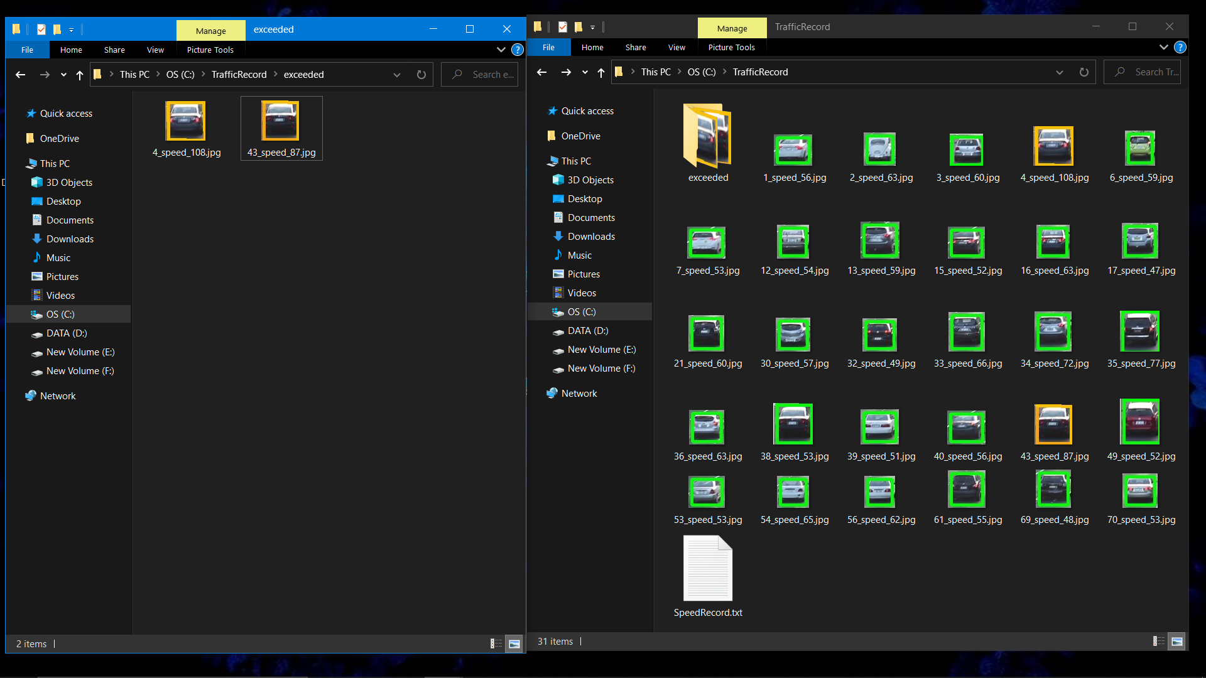
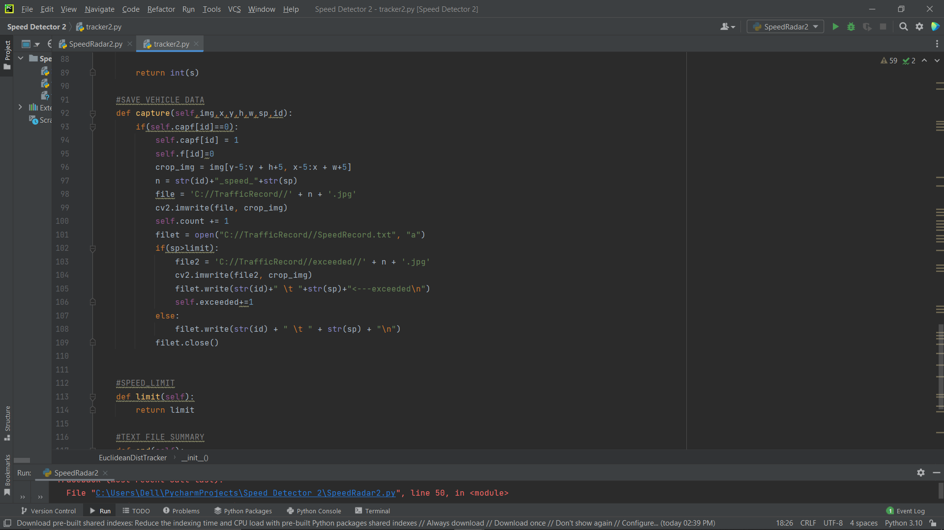
Crop Image based on contour detection
Save Vehicle Image in File
Save ID and Speed in Text File
Notes:
We have created folder named TrafficRecord, in which all the captured images and vehicle data are saved.
Then according to the parameters of bounding box we have cropped the image and save with the name ID_speed.jpg (26_speed_328.jpg)
Vehicle data gets updated simultaneously while the program is running. In this file we record the ID and speed of the vehicles that are stored in the array. We have set the speed limit to 80. if a vehicle exceede this limit it is displayed with the exceeded indicator in front of the speed and the images of these vehicles are saved in a separately in folder named exceeded.

Slide 27
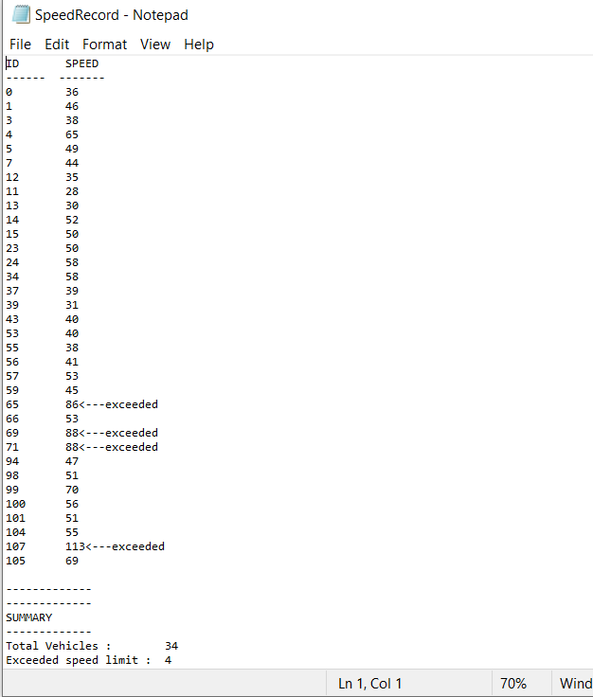
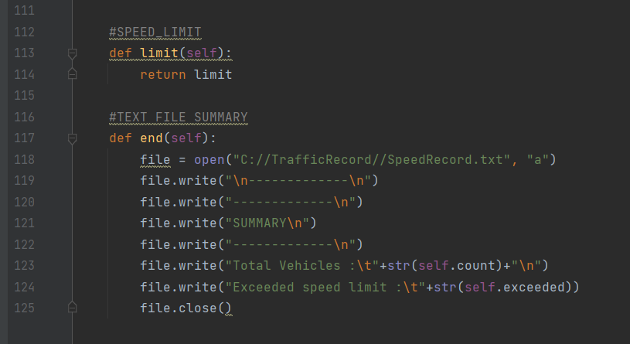
Add Summary in the end of Text File
Notes:
At the end, we count the elements in array count and array exceeded which are the number of cars passing on the road and total number of cars exceeding speed limit respectively and update it in the bottom of the text file.

Slide 28
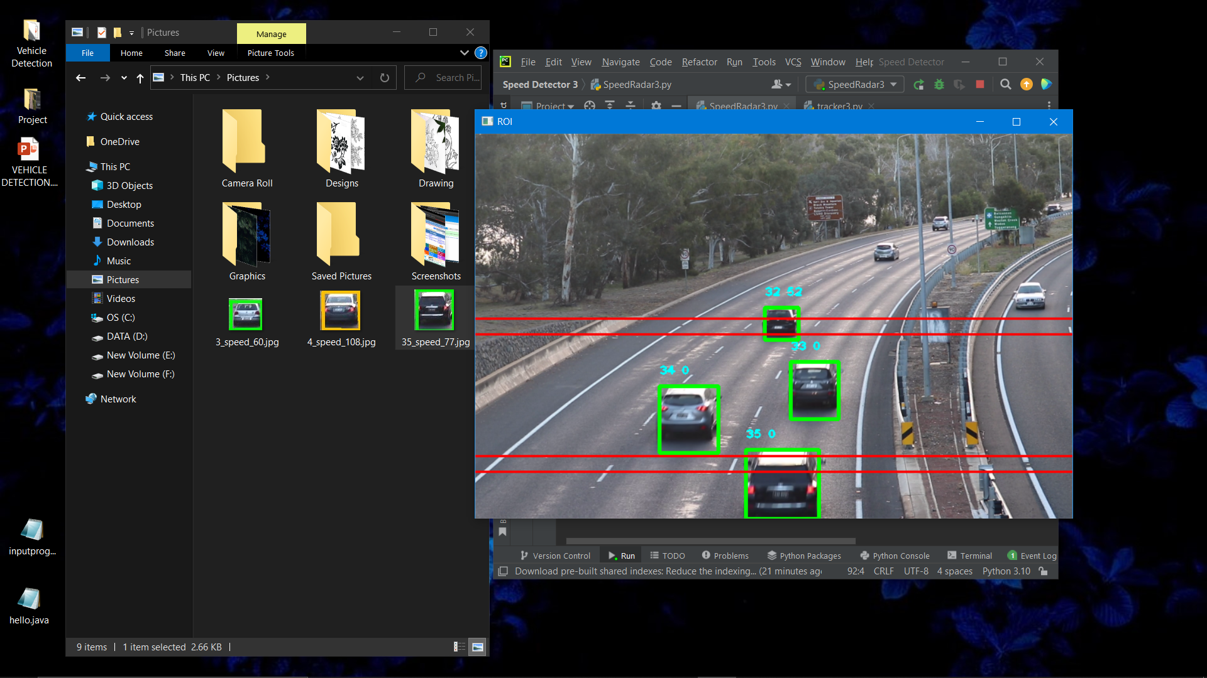
Notes:
This is a screenshot of output of the code, here it showing vehicle count and their respective speed. The red lines on the frame are the timer lines.

Slide 29
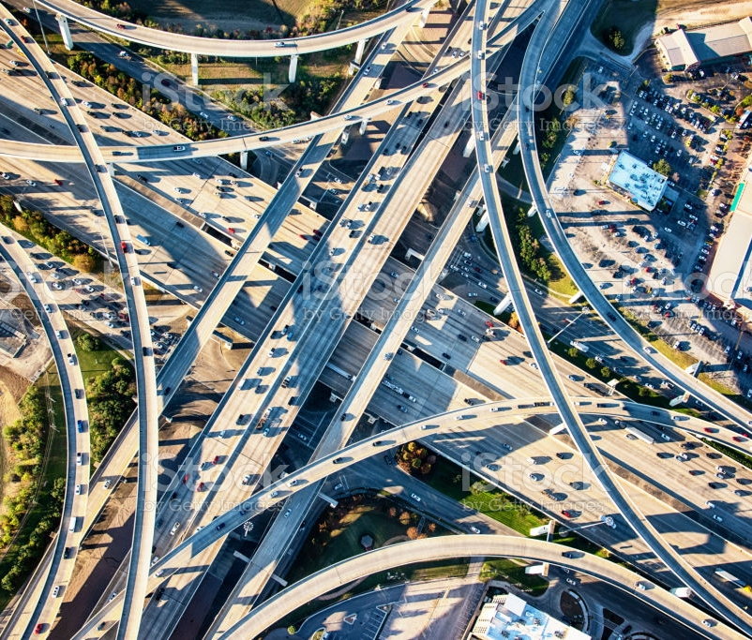
FUTURE SCOPE
Due to the low resolution of the video dataset number plate is not detected properly so future work is to collect high resolution video dataset which helps for detecting vehicle number plate properly and execution speed of the algorithms used is a crucial measure to be taken into account while developing vehicle speed estimation architecture.
Notes:
Read the Slide

Slide 30
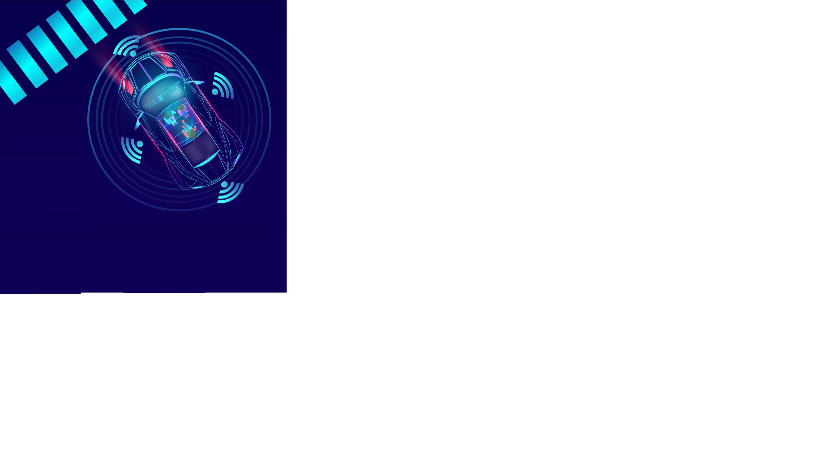
CONCLUSION
The proposed methodology involves the vehicle speed estimation which is done by using the image processing technique.
So, it can be concluded that speed estimation through video image processing is more efficient and economical than radar technology.
Notes:
Here we conclude that The proposed methodology involves the vehicle speed estimation which is done by using the image processing technique.
So, it can be concluded that speed estimation through video image processing is more efficient and economical than radar technology.

Slide 31
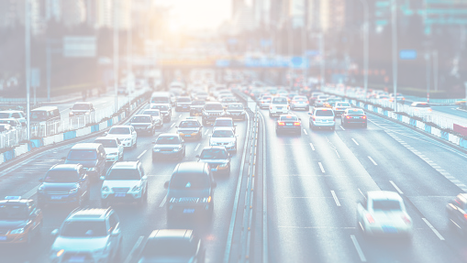
THANK
YOU

